Slide 1

Project Drishti
An AI-Powered Cognitive Command Center for Event Safety
Agentic AI Day – Powered by H2S
Team: MetaMind Mavericks
Prepared By: Sourav Ray, Aravind Kalla

Slide 2
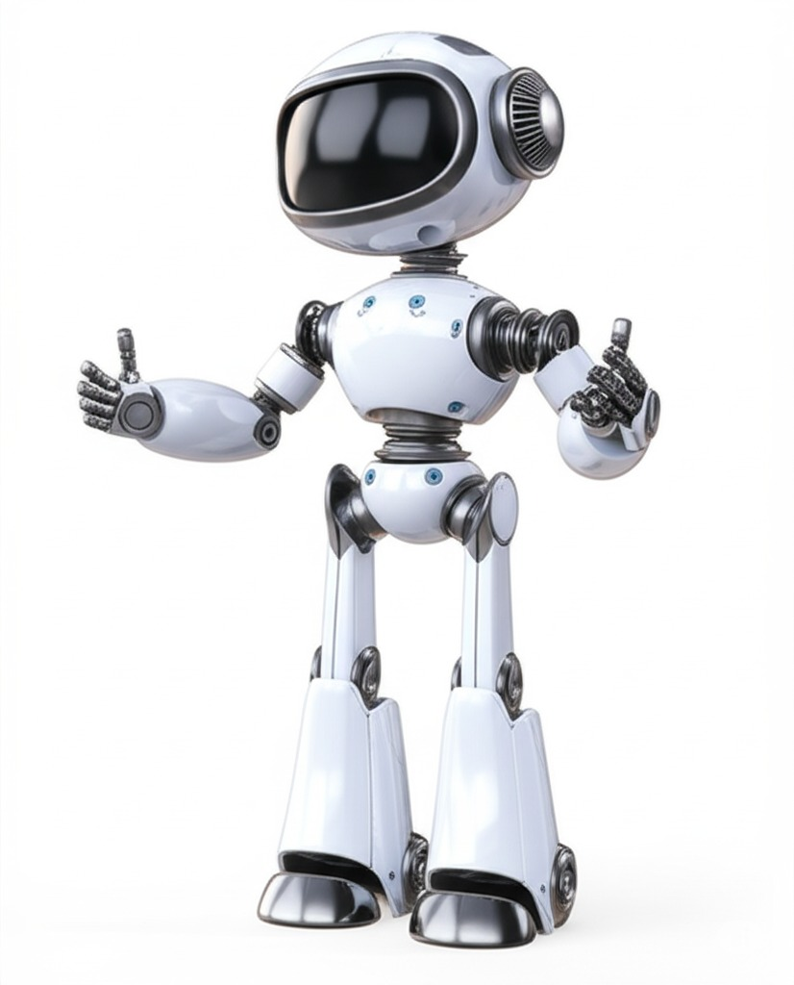
PROBLEM STATEMENT
Problem Statement 3: Improving Safety at Large Public Events - Event Safety is Reactive, Not Proactive. Data Overload: Commanders are flooded with disconnected video feeds, radio chatter, and reports. Delayed Response: It's impossible for humans to see every potential issue in real-time. By the time a problem is spotted, it's often too late. Siloed Information: Critical knowledge is buried in static documents (SOPs), completely disconnected from live events on the ground. Current systems record what happened. They don't predict what's about to happen.

Slide 3
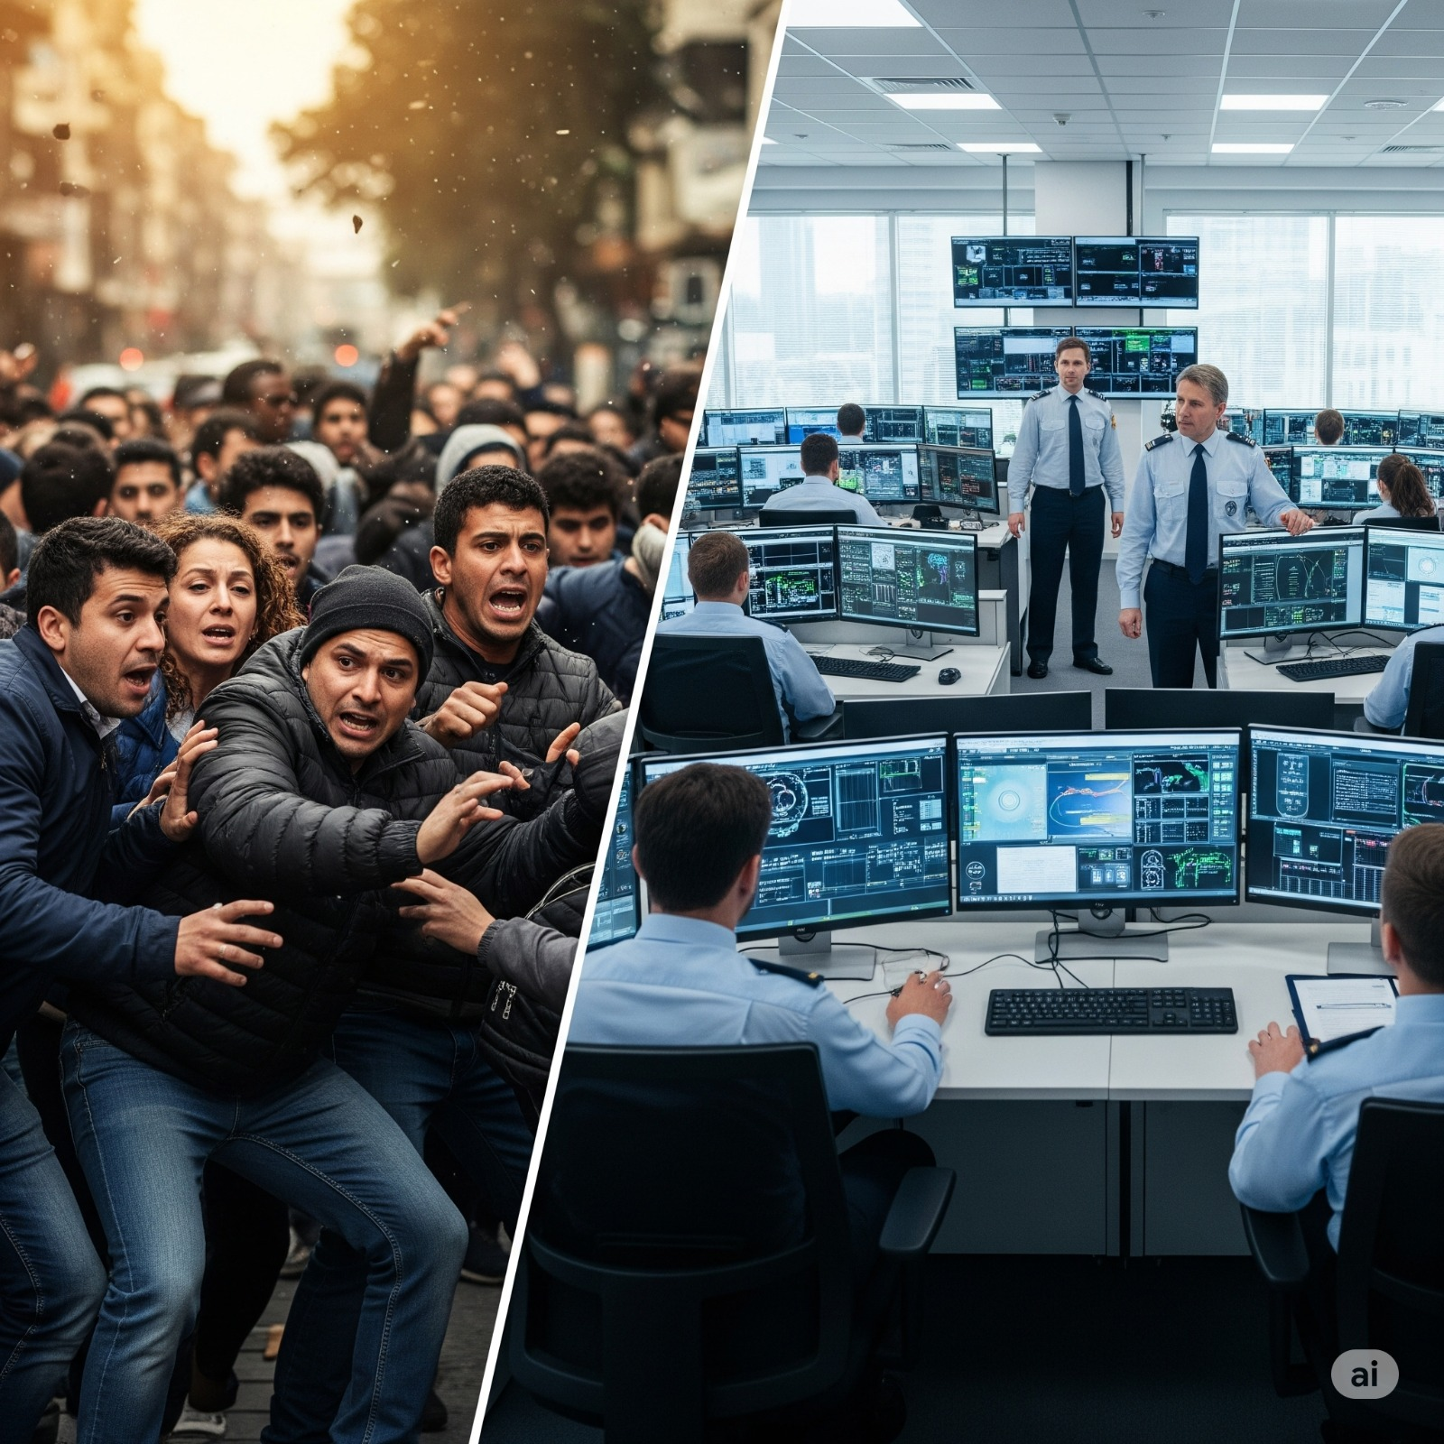
PROPOSED SOLUTION
Project Drishti is a situational awareness platform that acts as a central nervous system for event safety.
It transforms a command center from a passive monitoring station into an active, intelligent partner.
Our solution:
Perceives the environment through live video analysis.
Understands the context by fusing real-time data with operational procedures.
Empowers commanders to ask complex questions in natural language and get instant, factually-grounded answers.
Outcome: We're moving from "What happened?" to "What's happening, and what should I do next?"

Slide 4
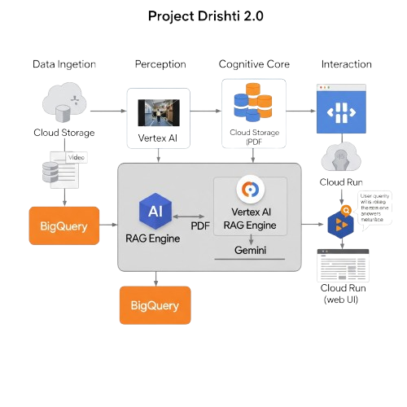
MVP Architecture
We built a fully functional MVP on Google Cloud, demonstrating the core data-to-action pipeline.
Ingestion (Cloud Storage):
Simulated video feeds and a Standard Operating Procedure (SOP) PDF are uploaded.
Perception (Vertex AI Vision):
A pre-trained Object Detector model analyzes the video, identifying and counting people frame-by-frame.
The results (timestamps, counts, locations) are streamed directly to a BigQuery table.
Cognitive Core (Vertex AI RAG Engine & Gemini):
The Vertex AI RAG Engine creates a knowledge base by indexing two sources:
Static Knowledge: The SOP PDF document.
Dynamic "Live" Data: The BigQuery table with real-time object counts.
Gemini acts as the reasoning engine, using the RAG Engine as a tool to retrieve context before answering a question.
Interaction (Firebase Web App):A simple web UI allows a commander to ask questions in plain English.

Slide 5

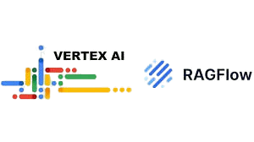


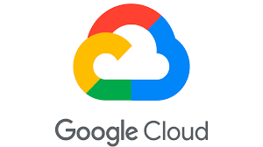
PREREQUITIES
NEW
Tech Stack Required

Vertex AI Vision: For scalable, real-time video analysis.

Gemini API: The state-of-the-art reasoning engine that understands context and provides intelligent answers.

BigQuery: As the high-speed data warehouse for all event analytics.

Cloud Storage & Cloud Run: For serverless data hosting and application deployment.

Vertex AI RAG Engine: To create a powerful, searchable knowledge base from diverse data sources.

Slide 6
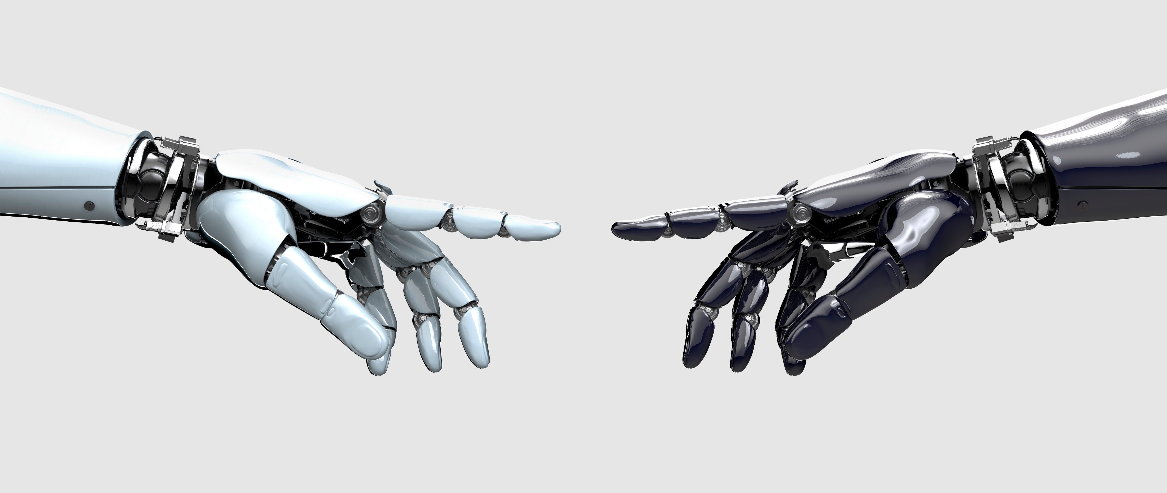
Thank You

